Slide 1

Introduction to R Shiny Day 1
Posit Implementation Programme
11/09/2023

Slide 2
Learning Outcomes – Day 1
Introduction: what is R Shiny?
Knowledge of packages relevant to R Shiny work
Shiny app breakdown: UI, Server
Overall layouts – eg. sidebarLayout (sidebarPanel, mainPanel), navbarPage, tabPanel, fluidRow, column
Reading in prepared data
Creating charts and tables – ggplot, DT
Accessible shinyWidgets and Reactivity: radioButtons and drop-down menus
Multi-tab dashboards

Slide 3
What is R Shiny?
Shiny is an open-source R package where you can create interactive web applications using Posit and R code
Shiny doesn’t require HTML, CSS or JavaScript knowledge, but can be extended with basic CSS themes, HTML widgets and JavaScript actions
Shiny works in any R environment and comes with pre-built and customizable output widgets for displaying plots, tables, and printed output of R objects
NOTE: functions associated with Shiny are generally written in CamelCase
Shiny power - check out an accessible PHS Shiny dashboard: National Therapeutic Indicators

Slide 4
R packages associated with R Shiny work
There are many packages you may find yourself using when creating a Shiny dashboard!
Some examples of key packages and their functions:
shiny – the package that allows all of this to be possible!
shinyWidgets – for action buttons, drop-downs, radio buttons and many more, check it out: https://shiny.rstudio.com/gallery/widget-gallery.html
shinymanager – securing and password protecting apps (great for pre-release access dashboards!)
shinyjs – for bringing basic JavaScript into R eg. enable and disable functions
shinyBS – create buttons and collapsible panels
shinycssloaders – for adding icon pictures to tabs
ggplot2, plotly, DT – for creating charts/tables
dplyr and readr – standard packages for data manipulation and reading/writing csv files

Slide 5
Shiny app breakdown
Shiny apps can be contained within a single script (not recommended for full dashboard building) or split across multiple scripts.
Small apps are contained within a single script called app.R which requires three main components to run the app:
user interface object (defined as UI): layout and appearance of your app.
server function (defined as server): instructions your computer needs to build the app.
A call to the shinyApp function: creates Shiny app objects from an explicit UI/server pair.

Slide 6
The User Interface (UI)
Controls what is displayed on the application page and how the components are laid out.
Examples:
navigation bars
text/titles
markdown elements
download buttons
plot outputs from server
user input widgets
Key point: Shiny uses the function fluidPage() to create a display that automatically adjusts to the dimensions of the users browser window. The above UI elements will generally be placed within this function.

Slide 7
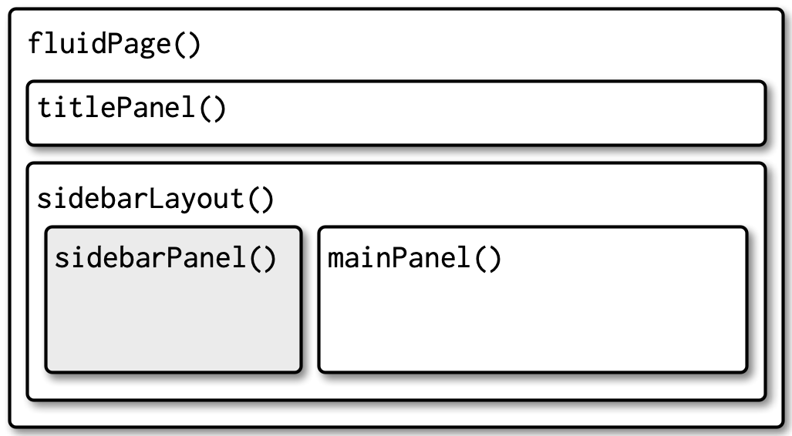
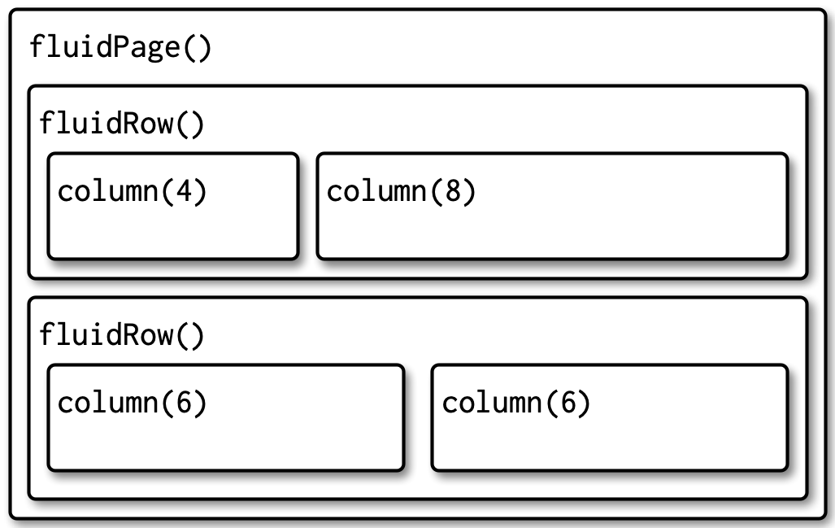
The User Interface (UI): Layout
The UI is built from nested functions specifying the app’s layout like a grid of layers
Filters, buttons, charts and tables are placed within the function for a specific space

Slide 8
The Server
The server-side controls everything that happens behind the scenes, for example, the data that will be displayed through the UI.
This part of the script defines how we generate all the plots and tables seen by the user.
It also defines how user inputs from our widgets (such as a user selecting from a drop-down menu) affects these plots and tables.
If necessary, the server section may also be used for minor data wrangling, such as filtering it in such a way that it can be fed into a plot.

Slide 9

Any questions so far?

Slide 10
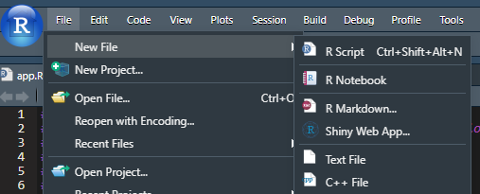
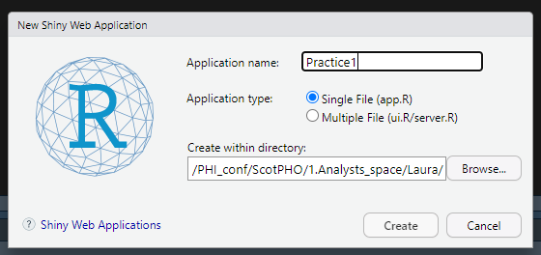
Code Along: the bare bones of a Shiny app
Open a new session in Posit.
Set working directory in stats drive.
Go to File > New File > Shiny Web App.
Name your app (anything you like eg. “Practice1”) and set file path (where you can save your practice scripts).
Ensure the Application type is set as Single File (app.R).
Click Create.

Slide 11
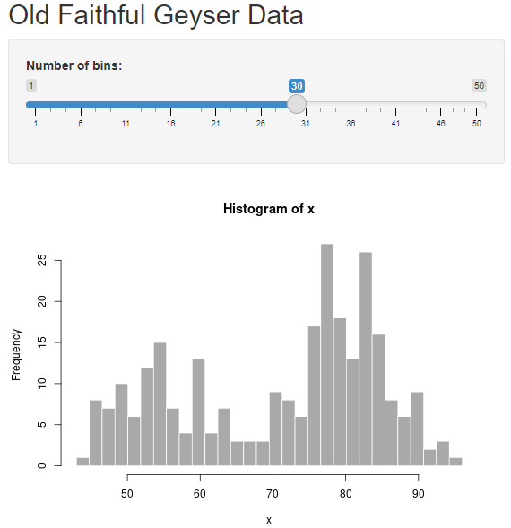
Code Along: the bare bones of a Shiny app
Upon creating the new Shiny Web App you will see some sample code related to the “Old Faithful Geyser” dataset.
Click “Run App” at the top right of the script window.
The app may run in a new window, or in the viewer pane (you can change between with the drop-down arrow at “Run App”).

Slide 12
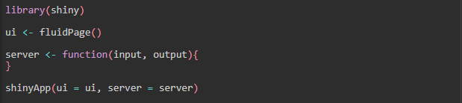
Code Along: Empty Shiny app
Remove all code relating to Old Faithful Geyser, leaving an empty app.
The app will run, because it has the three components required; ui, server and a call to the shinyApp() function
This is a good place to start building a new app.

Slide 13
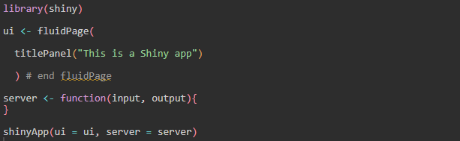
Code Along: titlePanel
Add title - Remember: it should go inside fluidPage()!
titlePanel() creates text formatted as a title at the top of the app.
“Run App” to see what happens!

Slide 14
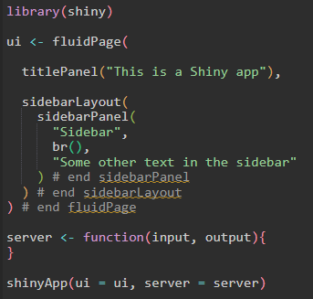
Code Along: sidebarLayout
Create a sidebarLayout() and add sidebarPanel().
Add some text to your app.
Use br() for new line.
“Run App” – what happens?
TIPS FOR UI:
Use Rainbow parentheses Tools>Global>Code>Display>Tick “Rainbow Parentheses”
Comment end of functions

Slide 15
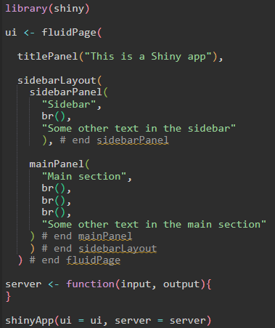
Code Along: sidebarLayout
Add mainPanel() and “Run App”.
NOTE: sidebarLayout() requires a sidebarPanel() and mainPanel()
sidebarPanel would contain user input controls (e.g. radiobuttons and drop-downs)
mainPanel would display the output (e.g. plot or table).

Slide 16
Recap
Shiny apps need two components; UI (controls how the app looks), and server (controls what the app does).
sidebarPanel() and mainPanel() functions work within sidebarLayout() and fluidPage() to create different sections of the app, and we can change the code in order to change what appears in these sections.
Next
Using sample data we will build our own multitab app which will include titles, radio buttons, drop-down menus, charts, tables and text.
We’ll be using the nyc_dogs dataset from the NYC

Slide 17
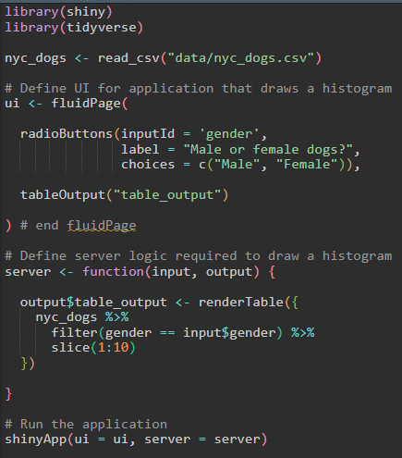
Code Along: Radio buttons
Clear content of app so you have an empty app with UI and server.
Load data from data folder.
Add radioButtons() to UI: radioButtons(inputId, label, choices = NULL)
inputId will be used to access the value. In this case the gender column of the dataset.
label names the radioButtons. In this case “Male or Female Dogs?”.
choices argument is a list of values to select from within the column we have chosen as the input. In this case we list Male and Female. Make sure they match what is in the data.
Add tableOutput(). The presence of the table is defined in UI but the table itself is created in server.

Slide 18
Code Along: Table output
Add the table output to the server by creating a table output object: table_output
Use renderTable({}) to select dataset, and filter the data based on the user input, in our case, gender: gender == “input$gender”.
The input$gender should match the radioButtons’ inputId in the UI and the output$table_output should match the outputId in the UI
Use slice(1:10) to only show the first 10 rows of the data.
1
UI
2
2
1

Slide 19
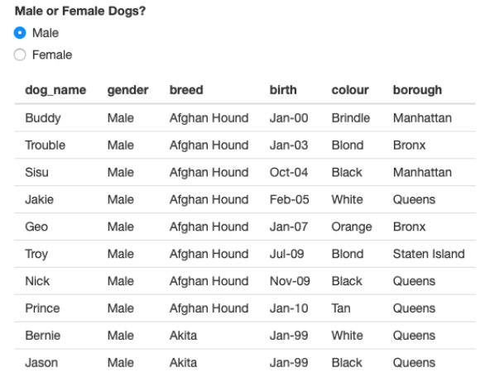
Code Along: Table output
Running your app will result in a table that looks like this, where you can select the first 10 male or female dogs using the radioButtons.
We can make the table more interesting using the DT package and the dataTableOutput() and renderDataTable() functions.
For more info on the DT package: https://rstudio.github.io/DT/

Slide 20
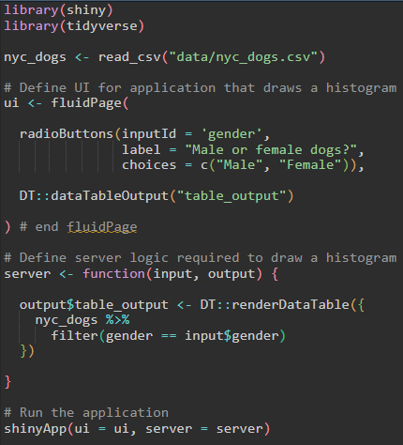
Code Along: DT table
Our code is very similar.
UI
DT::dataTableOutput(“table_output”) instead of tableOutput(“table_output”)
Server
DT::renderDataTable({…}) instead of renderTable({…})
Using DT to sort and search our data also means we no longer need the slice(1:10) function in the server.

Slide 21
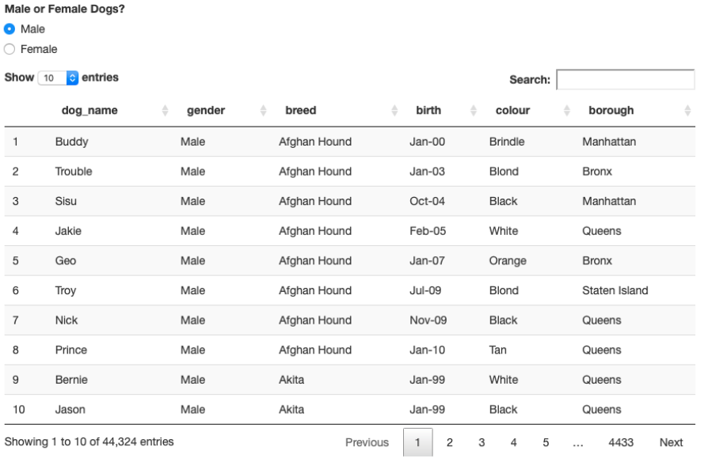
Code Along: DT table
Your app will now look something like this, where you can sort the data in the table and search through it.
Other DT features
Filter columns
Data formatting (e.g. £ and %)
Extensive styling options
Data download buttons
We will use the standard table output for the rest of the session.

Slide 22
Code Along: fluidRow() and multiple filters
fluidRow() is another layout option to sidebarLayout() and works with the column() function
fluidRow: Divides the screen into a horizontal grid
column: Divides the fluidRow into columns, max 12
Drop down filters are created using selectInput(inputId, label, choices)
inputId will be used to access the value.
label names the drop-down.
choices argument is a list of values to select from within the column we have chosen as the input.
Full widget/filter selection can be found here:https://shiny.posit.co/r/gallery/widgets/widget-gallery/. NOTE: some widgets are not accessible e.g. sliders.

Slide 23
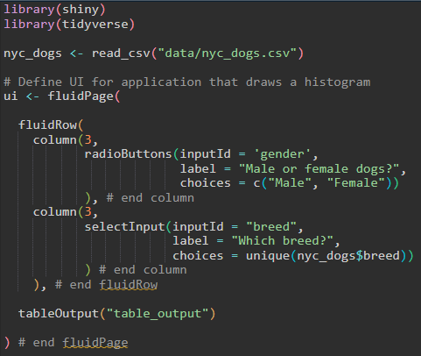
Code Along: fluidRow() and multiple filters
Add fluidRow()
Add your radioButtons() for gender into a column(3) and a selectInput() for breed into a column(3).
Get breed choices from nyc_dogs data with choices = unique(nyc_dogs$breed)
NOTE: Change back to standard tableOutput()
“Run App” and try your filters. What happens?

Slide 24
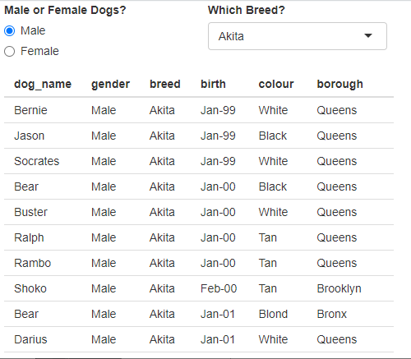
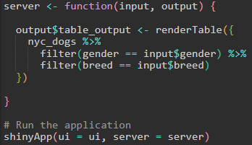
Code Along: fluidRow() and multiple filters
We must add the server component for the new breed filter!
Add a filter for breed in the table_output.
Remember to use the correct inputId from UI
“Run App”

Slide 25
Exercise
Add two more drop-downs to the app we have which allow you to filter for:
Borough, inputId = “borough”
Dog colour, inputId = “colour”
HINT: unique inputId, UI + server, max column width is 12

Slide 26
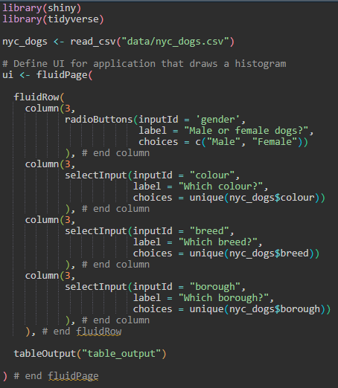
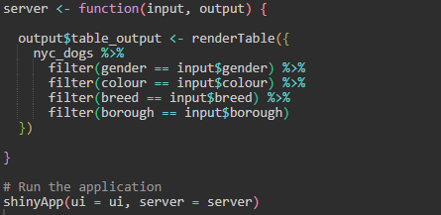
Answer
UI
Server
Next we will add charts!

Slide 27
Code Along: Charts
Plots are displayed using plotOutput() in the UI
In server, instead of renderTable({}), we use renderPlot({})
Plots are created using ggplot() and/or plotly() (a package for adding interactivity to charts).
You can create the plots in Plotly directly or pass a ggplot object to ggplotly(), turning your ggplot into an interactive plotly object. See here for more info on plotly: https://plotly.com/r/

Slide 28
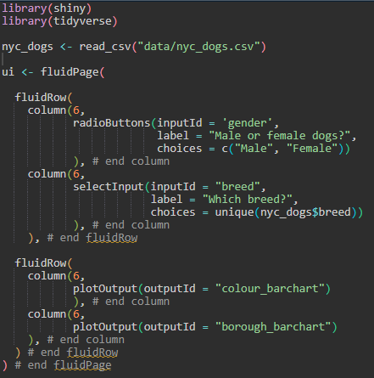
Code Along: Charts UI
Next, we will add two bar charts; one for colour and one for borough.
Keep the radio buttons for selecting gender, and the drop-down menu for selecting breed. Comment out the other filters.
Add new fluidRow() with two columns() and add one chart in each; “colour_barchart” and “borough_barchart”.
Remember to use plotOutput()

Slide 29
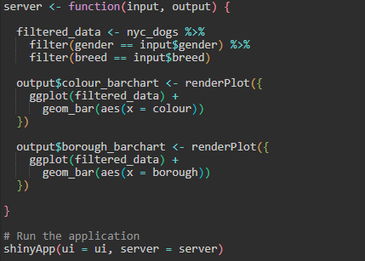
Code Along: Charts Server
Create a dataset called filtered_data that filters based on user input for gender and breed
Creating a separate dataset prevents us from repeating the data code for each plot
Create two bar charts using ggplot(); colour_barchart and borough_barchart. The names must match the outputId in the UI
Remember to use renderPlot({})
“Run App” – what happens?

Slide 30
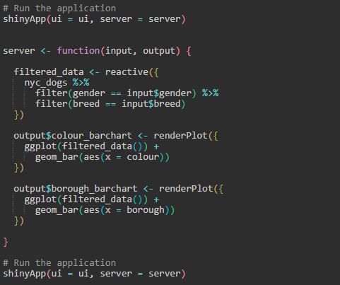
Code along: Reactivity
When we run the previous code, we get an error.
Do you need to wrap inside reactive() or observer()?
We’ve used regular R code to filter our data, but the filter for this object needs to be reactive depending on what the user inputs.
A reactive object can change during the running of the app, in our case, filtered_data.
Wrap filtered_data in the reactive({}) function.
This defines the data as having a reactive value and must therefore be followed by brackets when used; filtered_data()
“Run App”

Slide 31
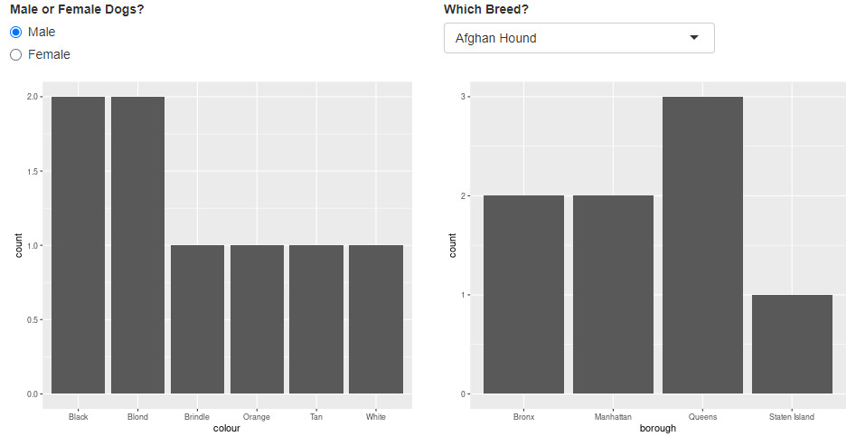
Code Along: Charts
Our app should now look like this, where the bar charts are reactive to selections made by the user either by the radioButton or the drop-down menu.

Slide 32
Recap
We have created an app which displays our NYC dogs data in a table which can be filtered using radioButtons and drop-down menus.
We have also created an app which displays our NYC dogs data in bar charts which are reactive to radioButtons and drop-down menus.
Next
A multi-tab dashboard where we can display both tables and charts
An introduction to navbarPage() which creates a navigation bar along the top of the app, and tabPanel() which is used to create different tabs within the navigation bar.

Slide 33
Including multiple tabs
Multi-tab dashboards require a lot of nesting of functions within other functions.
Having Rainbow Brackets activated is really helpful (compulsory) for this!
To have, for example, charts in one tab and the table in another, we need to wrap each code block (one for charts and one for tables) inside its own tabPanel() function.
These tabPanel()s then need to be nested inside the navbarPage() function which creates the overarching navigation bar along the top of the app.

Slide 34
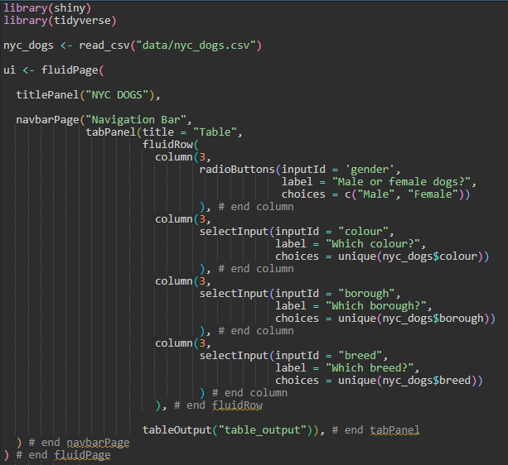
Code Along: Multiple tabs – Tab 1 (Table) UI
Create and name a navbarPage() with a nested and named tabPanel(title = “”).
Add your fluidRow() with your four filters (uncomment the borough and breed drop-downs) to the tabPanel().
Only keep the tableOutput(“table_output”) – remember to keep it in the tabPanel()

Slide 35
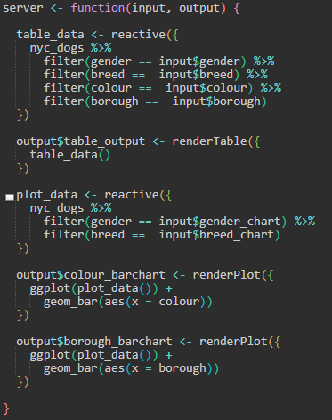
Code Along: Multiple tabs – Tab 1 (Table) Server
Create a new reactive dataset, table_data
Remember to add your four filter inputs
“Run App”

Slide 36
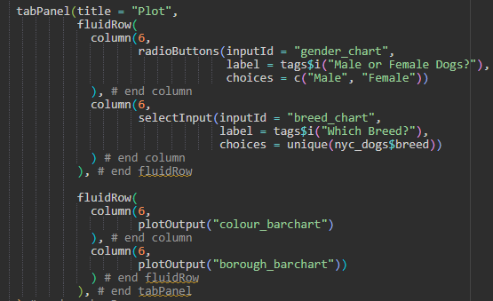
Code Along: Multiple tabs – Tab 2 (Chart) UI
Create and name a second tabPanel().
Add your fluidRow() with two new filters; gender and breed. They need new inputIds as every filter needs a unique id.
Add another fluidRow() with the two bar charts we made earlier.
NOTE: You can use tags to make changes to your font. E.g. tags$i() is italic and tags$b() is bold.

Slide 37
Code Along: Multiple tabs – Tab 2 (Chart) Server
Create a new reactive dataset, plot_data
Remember to add your two filter inputs with the new inputIds
Add the two bar charts you made before, remember to use your new reactive dataset
“Run App”

Slide 38
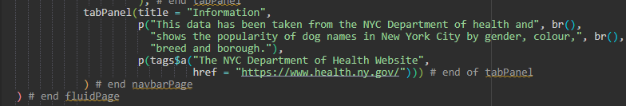
Code Along: Multiple tabs – Tab 3 (Info) UI
Create and name a third tabPanel().
Add text to your new tabPanel using p().
p() indicates a paragraph
Use tags$a to create a link to the NYC Department of Health website.
No need to update server as we only add text.

Slide 39
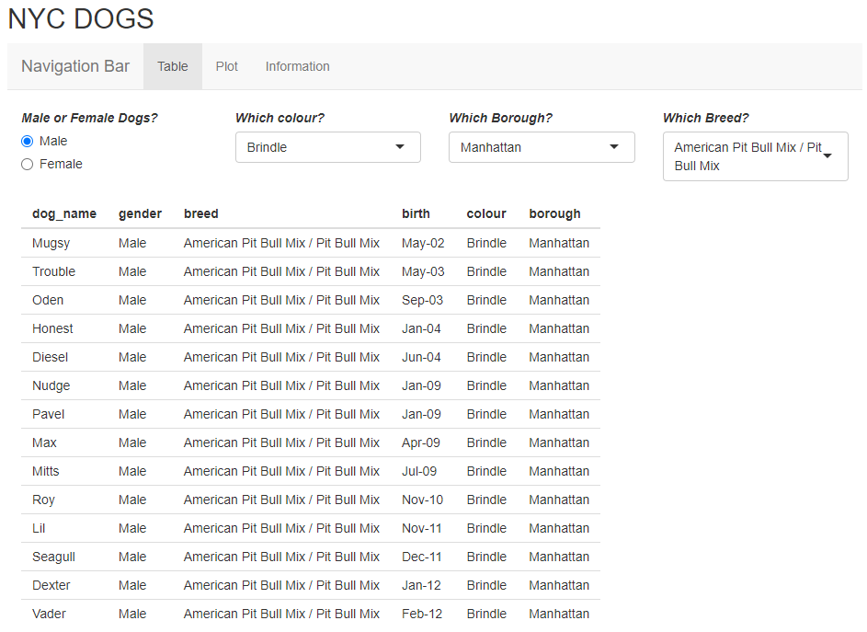
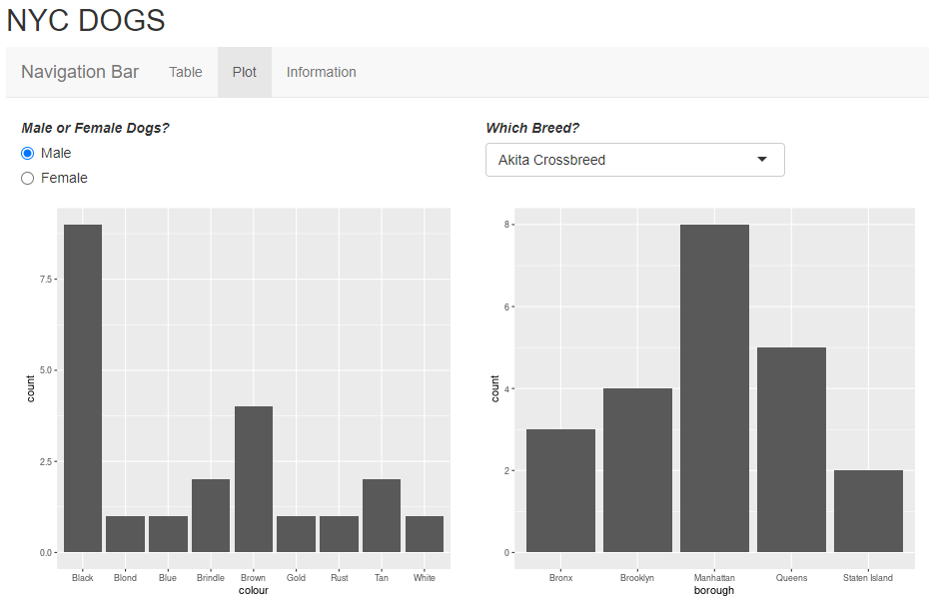
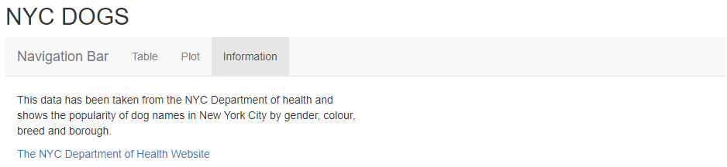
Code Along: Final app

Slide 40
Shiny themes and icons
We can use basic HTML and CSS code to set fonts and themes for our dashboard and insert icons in the navigation bar for each section.
Shiny has a variety of ready made themes that can be used in your dashboard, try out the theme selector: https://shiny.rstudio.com/gallery/shiny-theme-selector.html
There are also a variety of icons that can be added to your Shiny dashboard using Font Awesome and Glyphicon: https://fontawesome.com/v5.15/icons?d=gallery&p=2 https://getbootstrap.com/docs/3.3/components/#glyphicons
Some icons may be trapped behind a paywall, but many are free!

Slide 41
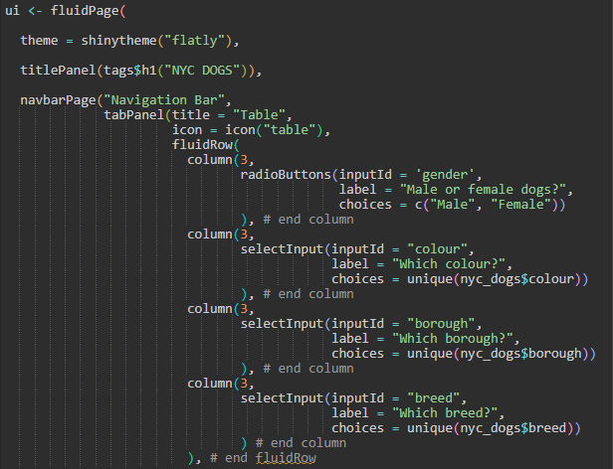
Shiny themes and icons
To use themes and icons, we need to load two more packages:
library(shinythemes)
library(shinycssloaders)
To add a theme, add theme = shinytheme(“name of theme”) in fluidPage()
To add an icon, add icon = icon(“name of icon”) to your tabPanel()
NOTE: You can wrap your NYC DOGS title in tags$h1() to set text as HEADER 1. Adding html tags aids screen readers.
EXERCISE: Add icons to all tabs. See previous slide for link to Font Awesome and Glyphicon

Slide 42
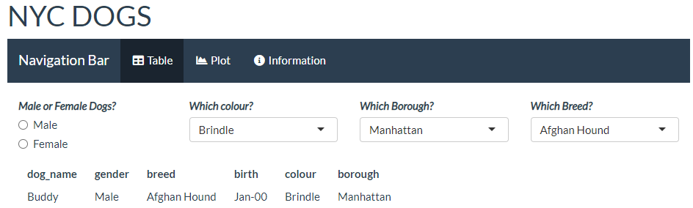
Exercise: Shiny themes and icons
Now our Shiny app looks a bit more interesting!
Use the theme and icons links to make your dashboard look nice!
If you are confident with ggplot2, make your plots look nicer or if you want a challenge, make them in plotly and play around with interactivity.

Slide 43
Practice makes perfect
You have created a Shiny dashboard from scratch which contains tabulated data, charts and information text tabs.
You have made the data reactive to whatever the user inputs and you have used different themes, icons and text formatting to make it stand out.
If you have time before our next session, try playing around with this dashboard.
Swap your fluidRow() and column() grid layouts for something else such as sidebarLayout(), sidebarPanel() and mainPanel() to see how the layout changes.
Add new tabs with different charts.
Attempt to make a similar dashboard for a whole new dataset.

Slide 44
Next time
Splitting big dashboards: UI, Server and Global scripts
Using multiple Public Health Scotland datasets
Use of specific Public Health Scotland colours and logos
Modals and help buttons
Data downloads
Deploying an app
The importance of using GitHub

Slide 45
End of day 1 – any questions?

